Slide 1
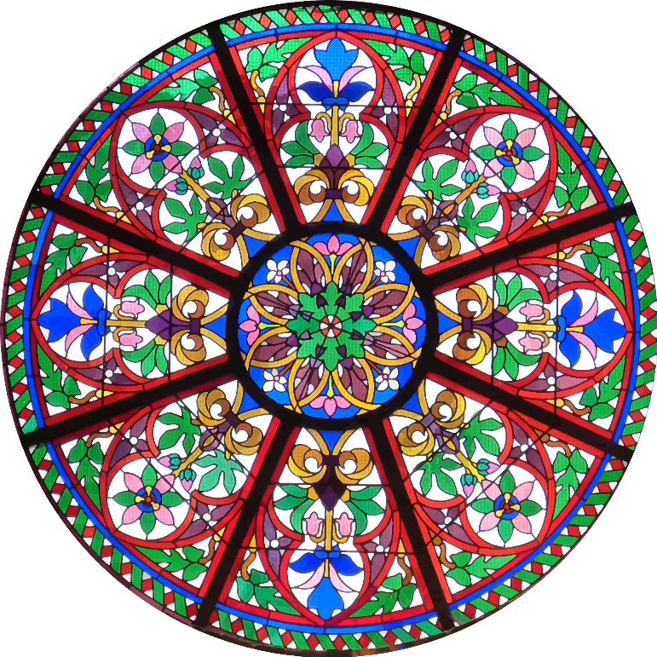
The diameter of this stained glass window is five metres. Find its circumference giving your answer in terms of π.

Slide 2

Find the area of the front of this clock if its radius is 15cm giving your answer as a multiple of π.

Slide 3

This is three quarters of a circle with a radius of 24mm. Find its area in square millimeters giving your answer in terms of π.

Slide 4
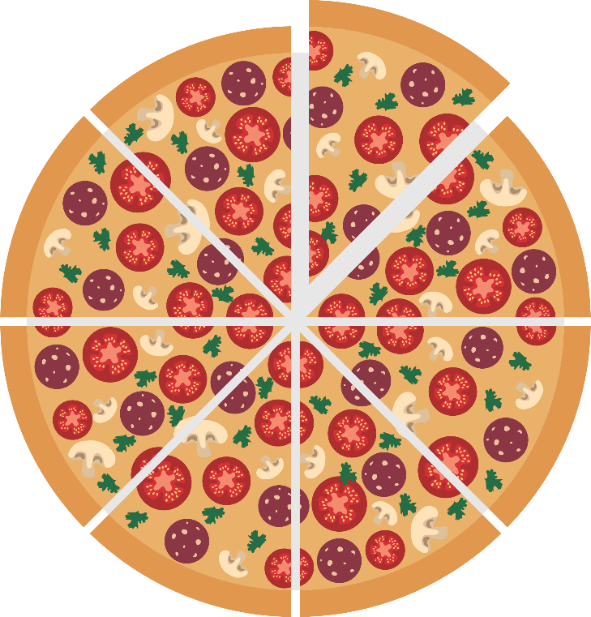
Assuming each slice of pizza is a sector of the same size, find the area of the top of one piece of this eight inch radius pizza. Give your answer as a multiple of π.

Slide 5

Assume this can is a cylinder with height 11cm and radius 4cm. Find its capacity in cubic centimetres giving your answer in terms of π.

Slide 6
A plastic tile is in the shape of a 4 by 8 rectangle joined to a semicircle as shown. Find the area of this shape and include a multiple of π in your answer.
8cm
4cm

Slide 7

Assume this can is a cylinder with height 9cm and radius 3cm. Find its total surface area (top, bottom and curved surface) in square centimetres giving your answer in terms of π.

Slide 8
The diameter of the large circle is 10cm and the diameter of the smaller circles are each 5cm. Find the size of the blue area in square centimetres giving your answer as a multiple of π.

Slide 9
This disk is a cylinder with width 25mm and radius 40mm. Find its volume in cubic centimetres giving your answer in terms of π.

Slide 10
This green shape is a sector of a circle with radius 15 inches and an angle between the two radii of 24º. Find the perimeter of the sector in inches giving your answer including a multiple of π.

